Slide 1
EBS Applications Summer Intern Presentation
Adittya Patil
Summer 2019
Enterprise Business Services
Manager Margo Rush

Slide 2

About Me: Adittya Patil
- From / Interests / Hobbies: Science, Sports and Name of School: Rocky Hill, CT. Electric Cars, Aerospace, Playing/Watching Basketball, Running (XC), Coding.
- Year in School , Expected Graduation Date
Senior in High School, June 2020
- Manager: Margo Rush
- Buddies/Mentors: Yeshi Soleti, Pat Bosse

Slide 3
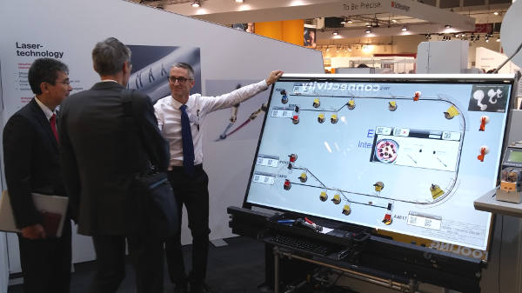
Major Assignments
Project: File Conversion from Cadra/Catia to DXF for Laslec Boards
Assignment:
Role:
Engineer-To convert the Catia Files to DXF files
Tasks:
Check a file converter which converts files from Catia to DXF and HPGL format

Slide 4
Major Assignments
Project: Mentor Capital Implementation
Assignment:
Role:
Data Specialist
Tasks:
Sorting out parts by writing/editing SQL queries and organizing the data into excel spreadsheets

Slide 5

Major Assignments
Project: Navair Migration
Assignment:
Role:
Engineer-C#
Tasks:
Helped Fix the C# script that broke due to an Office 365 update while migrating the data to a new database in DCI from Meriden

Slide 6

Major Assignments
Project: AWS Gameday
Assignment:
Role:
Attack Scribe
Tasks:
Record the details of each of the attacks, such as a shutdown attack

Slide 7


Skills Developed
-Experience Gained:
-I learned new coding languages (C# / SQL)
-Chaos Engineering
-Got an insight into the operations of a major company
-Team collaboration
-Continuous Improvement
-What I liked about the internship
-learned how to act in professional setting
-learned how to develop professional skills
-learned how to collaborate and develop a team mindset
-What I didn’t like about the internship
-I wish I started sooner

Slide 8

Future Endeavors
-Future Goals:
-I would like to attend college for computer science or engineering.
-Work in ATL (Advanced Technologies Laboratory)
-Learn about different AI and quantum computing technologies
-What did you attend?
Site Tours
Sikorsky shop floor and wiring harness area
Summer Intern Activities
- AWS gameday - Intern day

Slide 9
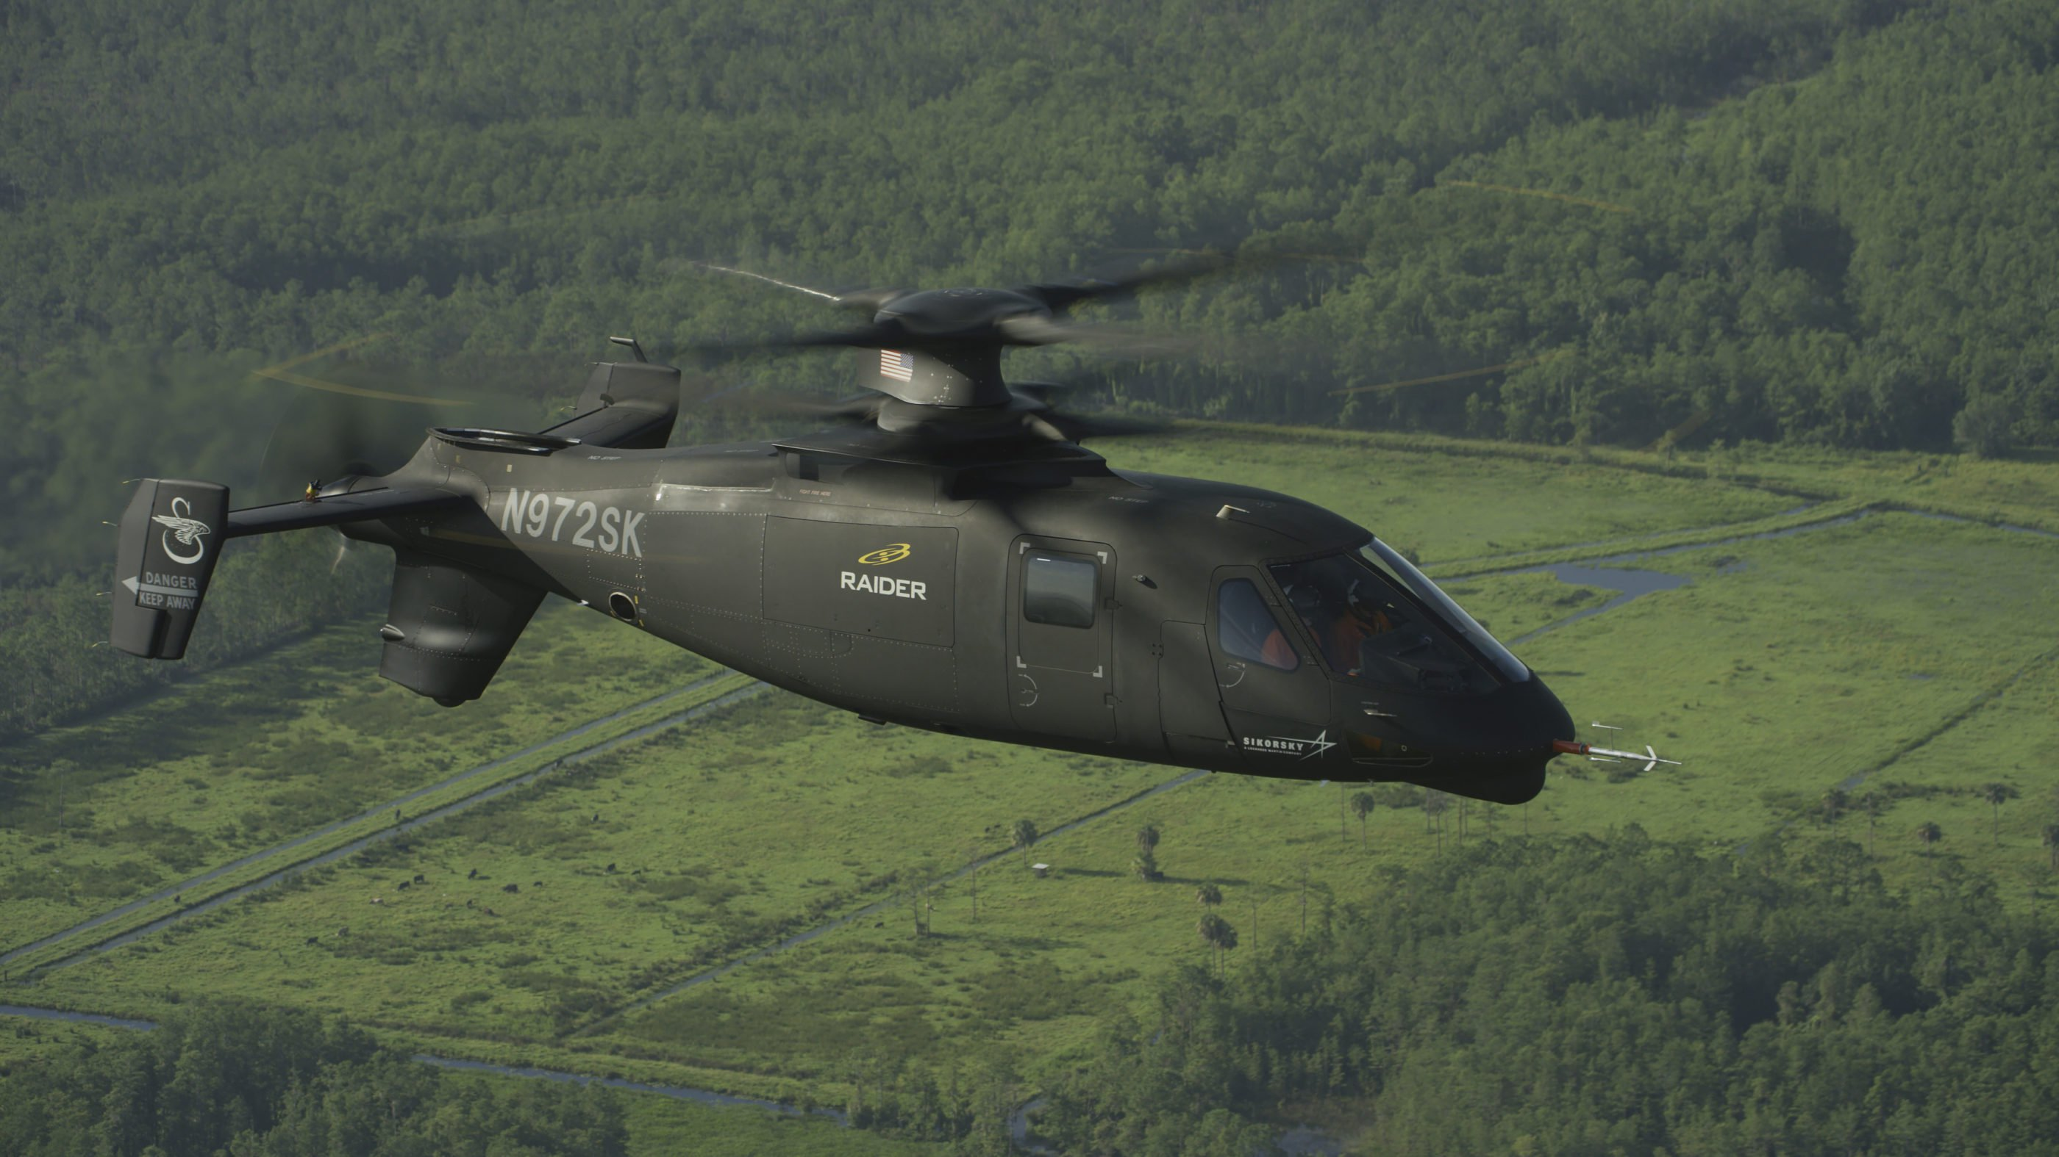
Thank you!

